Slide 1
def ai_plus_you(developer):
response = ai.create(
prompt=developer,
)
return response.developer.awesome
David Orlowski
1

Slide 2
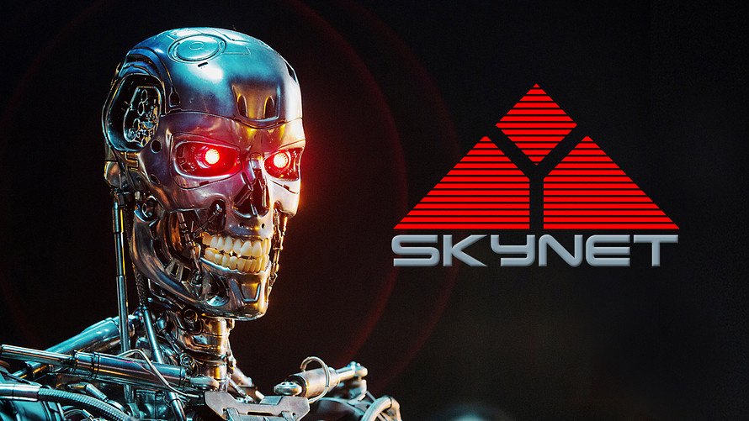
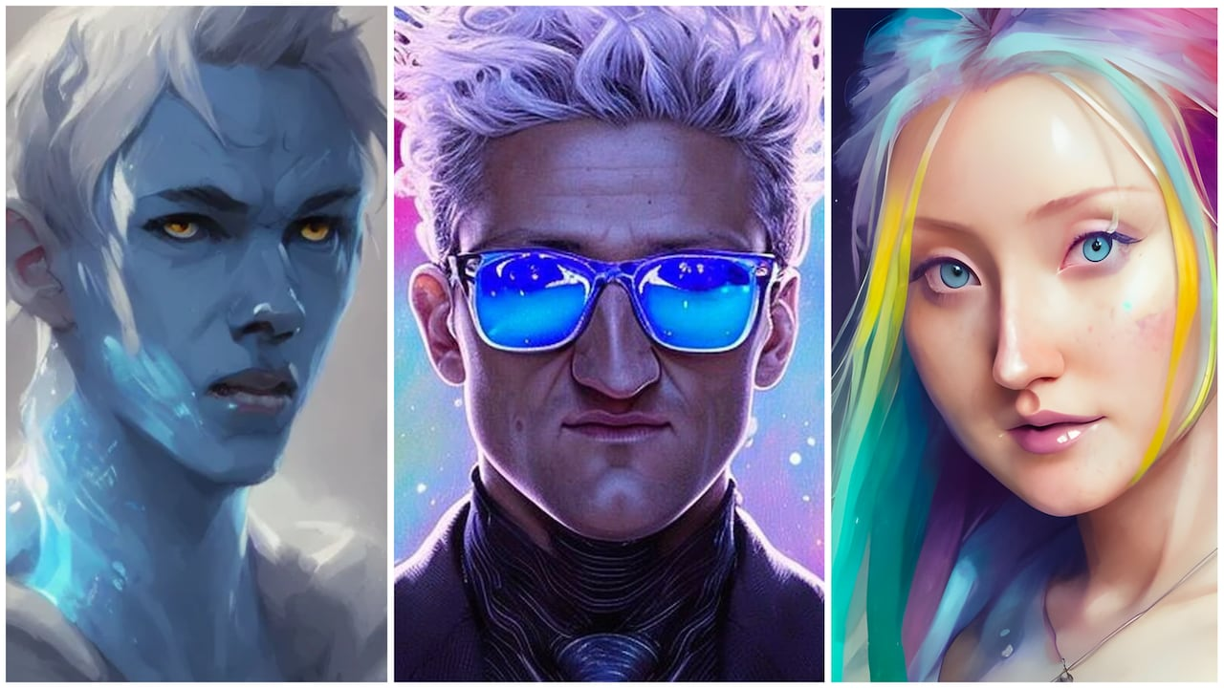
The Dawn & Emergence of AI
Not an Ethics question for us to tackle today
No AI was used to create this presentation….or was it?
2

Slide 3
What can we use AI for?
Art
Creative Writing
Code review & generation
Summarizing (condensing lecture notes?)
Educational assistance
Chats and conversations
Customer sentiment / CS
Gaming! Generating NPCs & dialog Translations
Medical Diagnosis
3

Slide 4
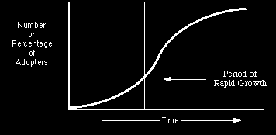
Where are we?
Maturity / Physical limit
4

Slide 5
Let’s make YOU a better developer!
Access to information
AI is another “tool” in your development toolbox
We are going to build a basic language neutral code analyzer/review tool (conversational “linter”)
We will be using OpenAI (the makers of ChatGPT)
5

Slide 6
ChatGPT Example
ChatGPT is a natural language based, conversational AI driven by an OpenAI “Engine”
“Please review the following Javascript code and provide feedback: <code>”
That’s it.
Our code snippet (JS):
Function multiply(a, b) {
return a * b;
}
6

Slide 7
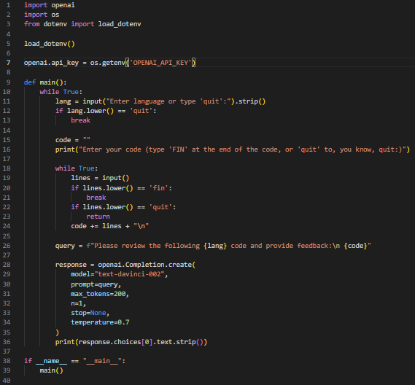
Using the API
Let’s do the “same thing” with
an API!
If obtain_an_API_key == True:
doAPIMagic();
7

Slide 8
Demos:
API & ChatGPT
8

Slide 9
The inverse can be true as well
Using AI like Chat GPT we can also “get” code and review it
AI “peer review”
Feedback optional :-)
Implement, test, improve
It SHOULD be used as a starting point, NOT a SOLUTION
9

Slide 10

A new challenger has arrived!
10

Slide 11

(Bard)
Beta & waitlisted (because of course it is…)
Very fast
Reasonable responses
Does not have all capabilities of OpenAI / ChatGPT
Content & quality are not equivalent
Seems to be more geared to search results (not surprising)
Probably going to be more specialized as opposed to general widespread usage (maybe?)
Suggests there is room for both players!
11

Slide 12
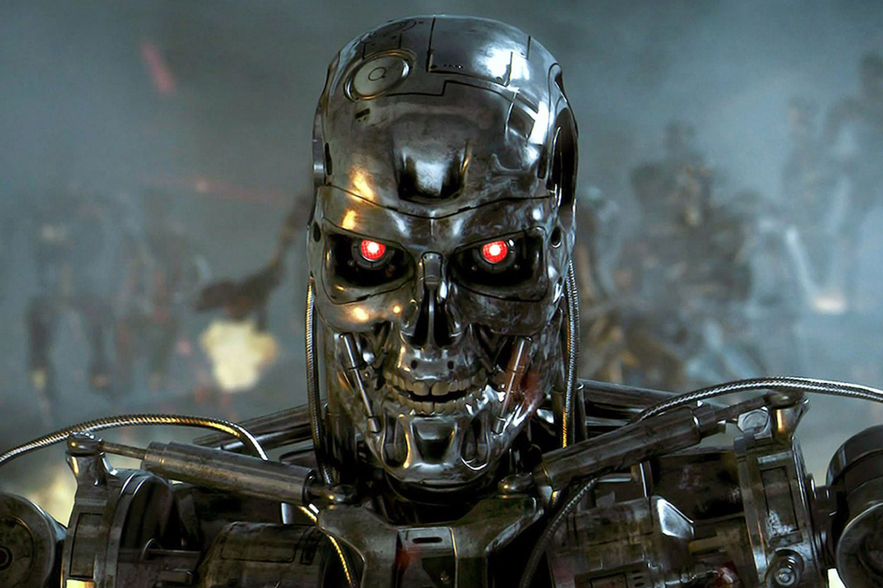
Wrapping it up
Did I use AI/ChatGPT to
create this
presentation?
Will ChatGPT or AI take
your job?
12

Slide 13
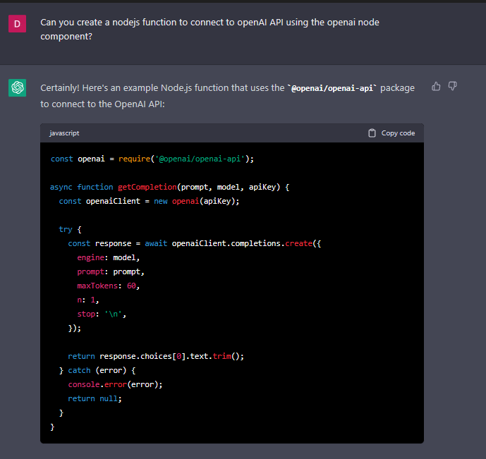
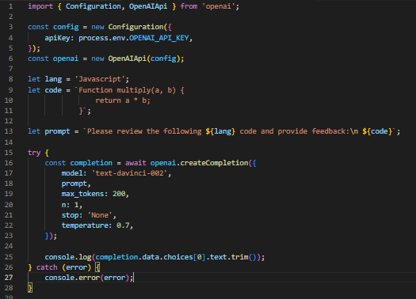
Your job is safe…
13

Slide 14
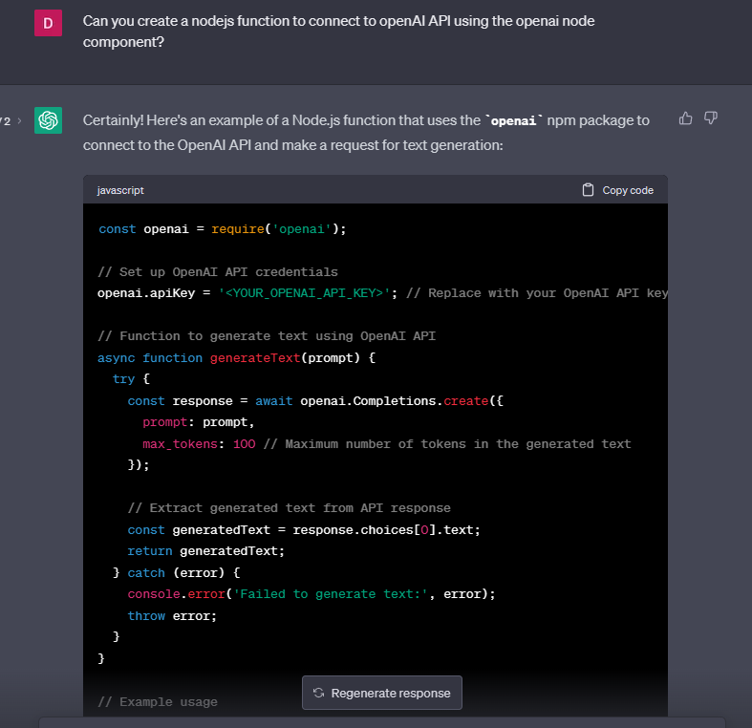
…or is it?
14

Slide 15
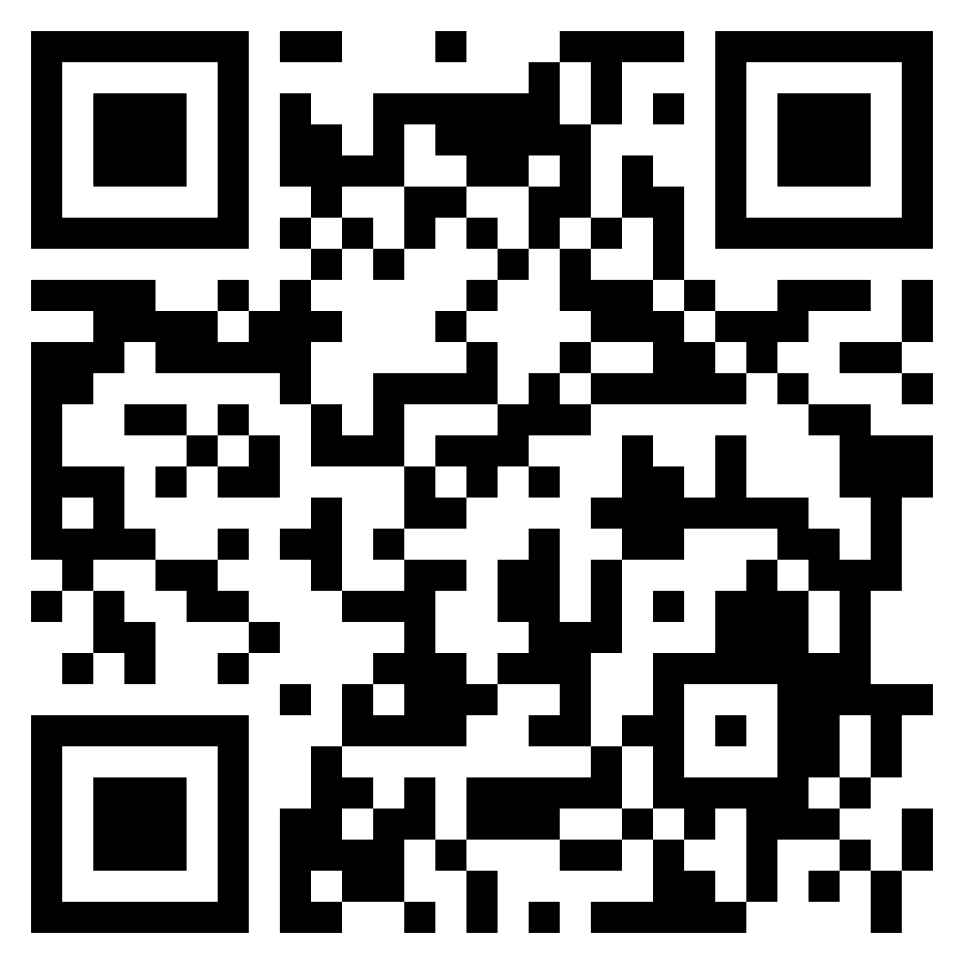
Thank you!
https://github.com/dagobah19/su-2023-ai

